Slide 1


Statistical Learning
Brief Introduction to The Terminologies and Main Concepts of Statistical Learning
林成鍇 Julius Ling @ 國立成功大學大數據與AI研究中心

Slide 2
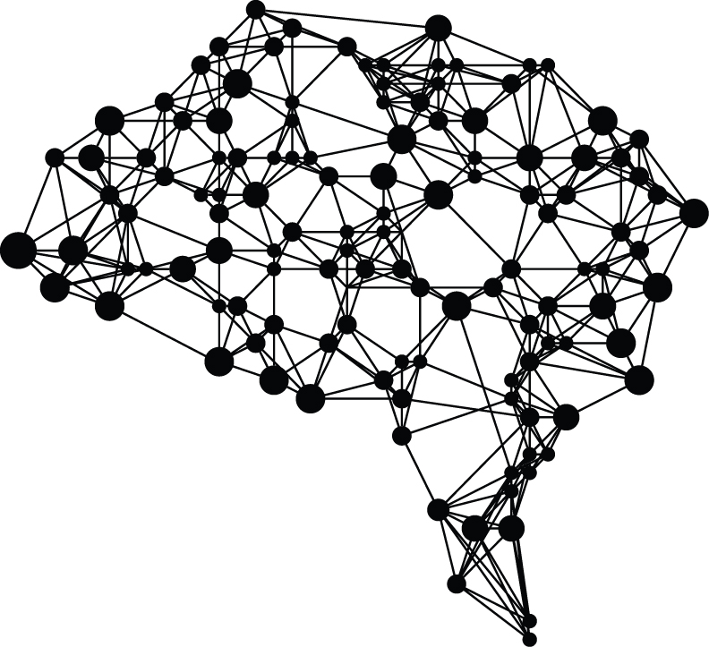
Outline
Course Overview
Terminologies & Concepts
Applications
Challenge of Modelling

Slide 3
Outline
Course Overview
Terminologies & Concepts
Applications
Challenge of Modelling

Slide 4
Teaching Strategies
Lecture
In-class Practice
1800-2100 on every Tuesday
@心理系階梯教室

Slide 5
Lesson | Date | Content | Content | Task
1 | 15/9 | Introduction & Fundamentals | Introduction of Statistical Learning
2 | 22/9 |  | Python Programming
3 | 29/9 |  | Data Preprocessing & Exploratory Data Analysis
4 | 6/10 | Parametric Modelling & Techniques | Linear Regression | Homework 1
5 | 13/10 | Parametric Modelling & Techniques | Logistic Regression
6 | 20/10 |  | Logistic Regression | Homework 2
7 | 27/10 |  | Regularization & Cross-Validation
8 | 3/11 | Nonparametric Modelling | Tree-Based Methods & Ensemble Learning
9 | 10/11 |  | Mid-Term Examination
10 | 17/11 |  | Support Vector Machine, K-Nearest Neighbors
11 | 24/11 | Deep Learning | Deep Neural Network | Homework 3
12 | 1/12 |  | Deep Neural Network
13 | 8/12 |  | Convolutional Neural Network | Homework 4 Final Presentation Proposal
14 | 15/12 | Beyond Supervised Learning | Bayesian Inference & Modelling, MCMC Method
15 | 22/12 |  | Unsupervised Learning
16 | 29/12 |  | Reinforcement Learning
17 | 5/1 |  | Final Examination
18 | 12/1 |  | Presentation Night

Slide 7
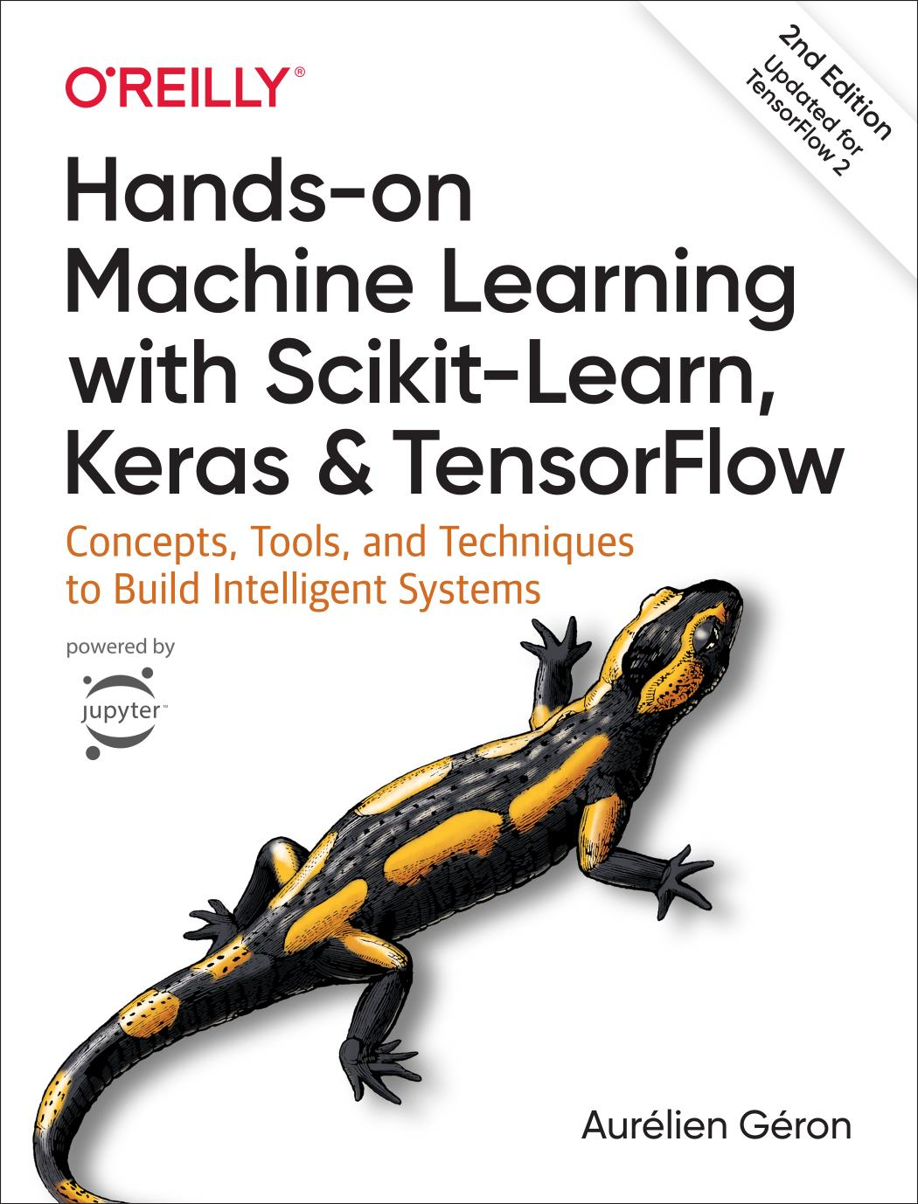
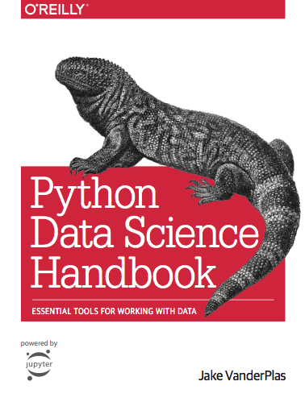

Slide 8
Instructor
胡中凡 教授
jfhu@mail.ncku.edu.tw
Teaching Assistants
白耀升
jim12312321@gmail.com
林成鍇 Julius Ling
juliuslsk@gmail.com

Slide 9
Outline
Course Overview
Terminologies & Concepts
Applications
Challenge of Modelling

Slide 10


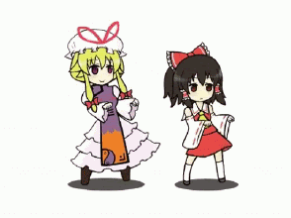
What is a model?

Slide 11
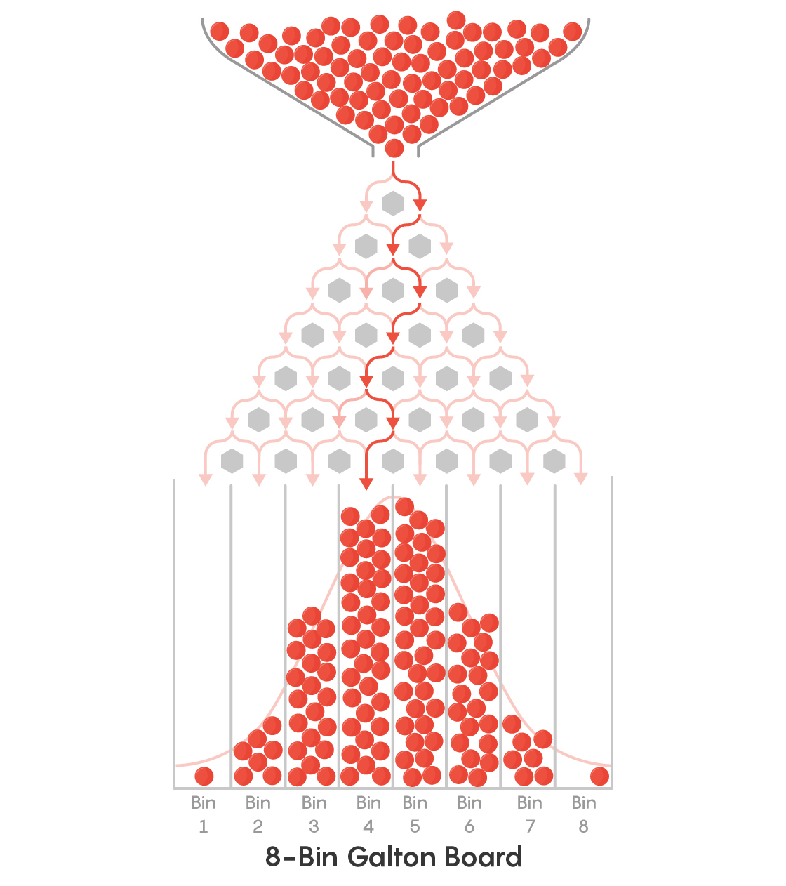
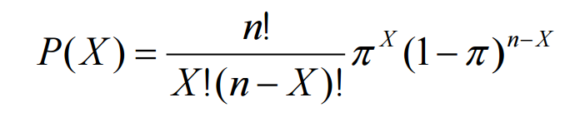

Slide 12
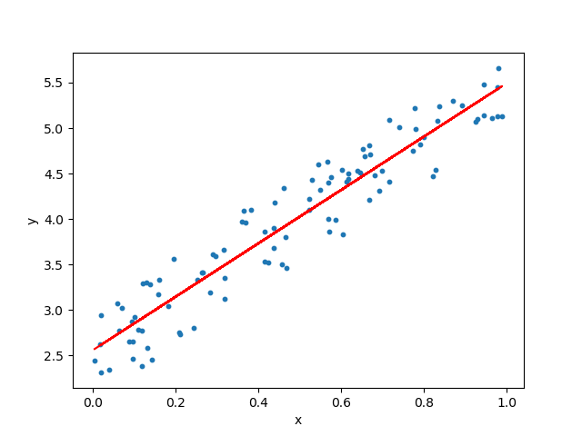
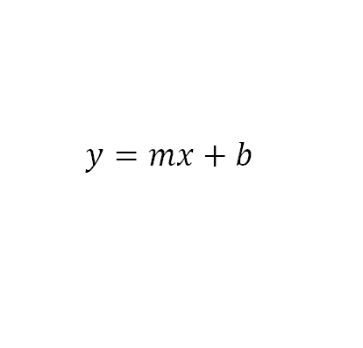

Slide 13
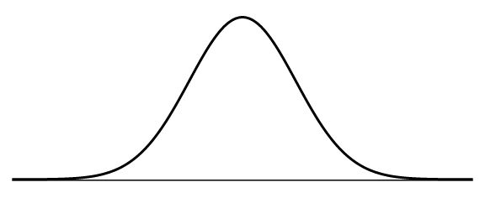
A good model depicts the very intrinsic characteristics of certain phenomena of interest with reasonable simplification.

Slide 14
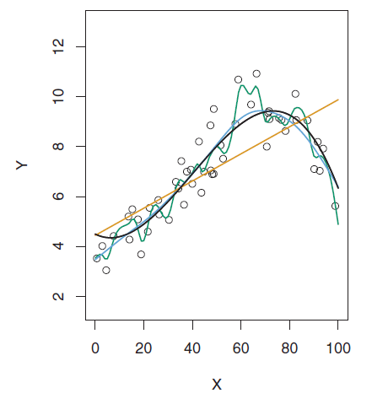
The Essence of Statistical Learning
(Single Variable)

Slide 15
Statistical Learning
Vs.
Machine Learning
Reference: Statistical modeling: The two cultures - L Breiman - Statistical science, 2001

Slide 16
Machine Learning
Vs.
Deep Learning

Slide 17
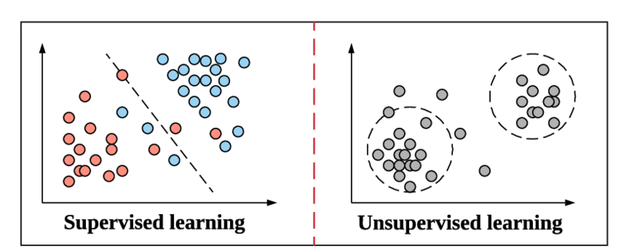
There’s also Reinforcement Learning (not going to touch on this within the following lessons).

Slide 18
Conventional Definition in Data Science
In a supervised learning model, the algorithm learns on a labeled dataset, providing an answer key that the algorithm can use to evaluate its accuracy on training data.
An unsupervised model, in contrast, provides unlabeled data that the algorithm tries to make sense of by extracting features and patterns on its own.
https://blogs.nvidia.com/blog/2018/08/02/supervised-unsupervised-learning/#:~:text=In%20a%20supervised%20learning%20model,and%20patterns%20on%20its%20own.

Slide 19
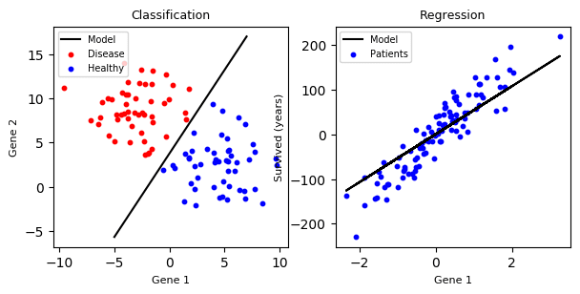
And the clustering task is introduced in the previous slide (Unsupervised Learning)

Slide 20
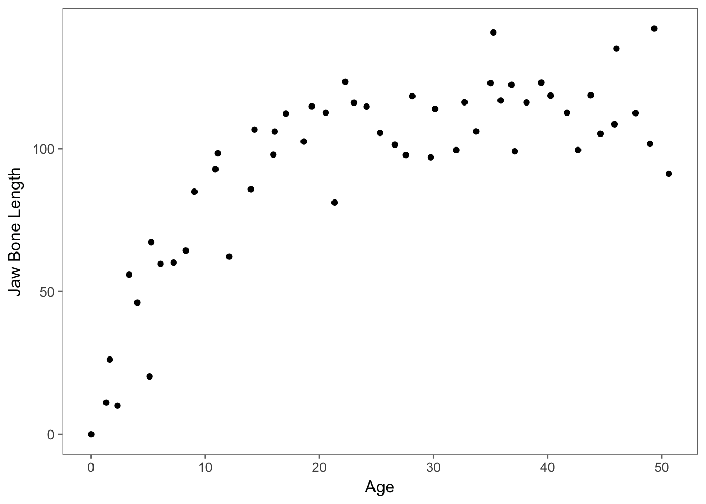
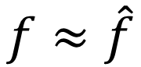
How are you going to
plot the graph?
$$f≈\hat{f}$$

Slide 21
Model-based
/ Parametric Approach

Slide 22
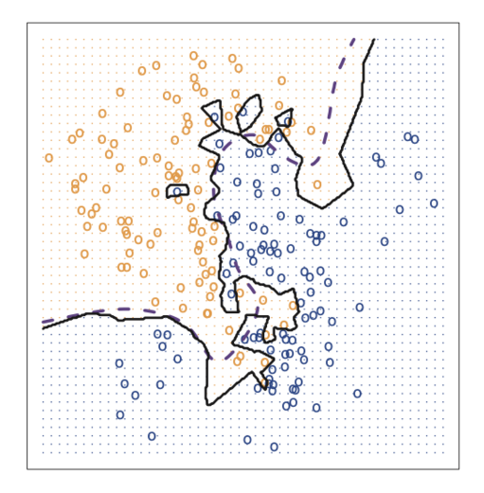
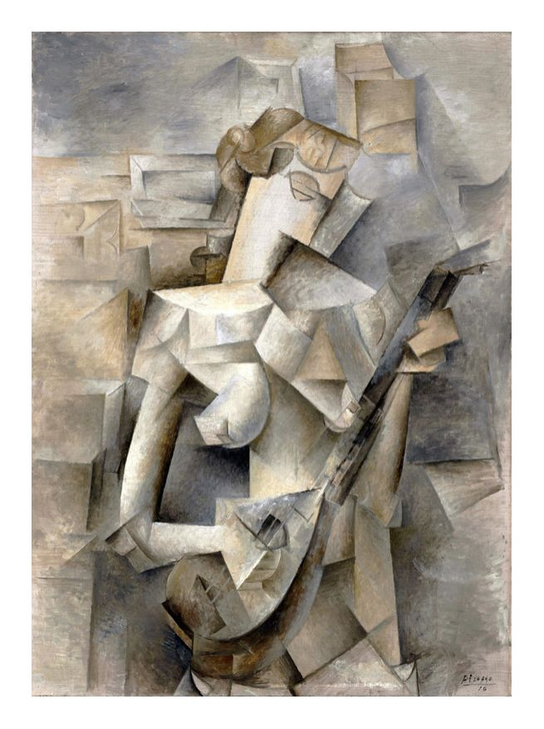
Instance-based / Non-parametric Approach
Girl with a Mandolin – Pablo Picasso 1910

Slide 23
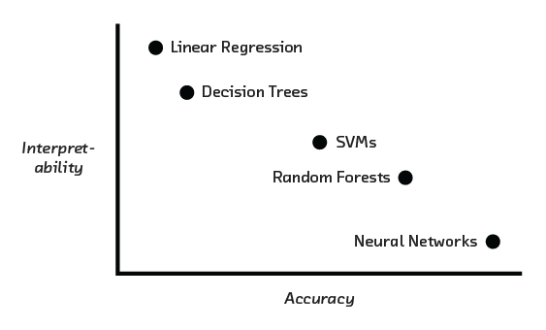

Slide 24
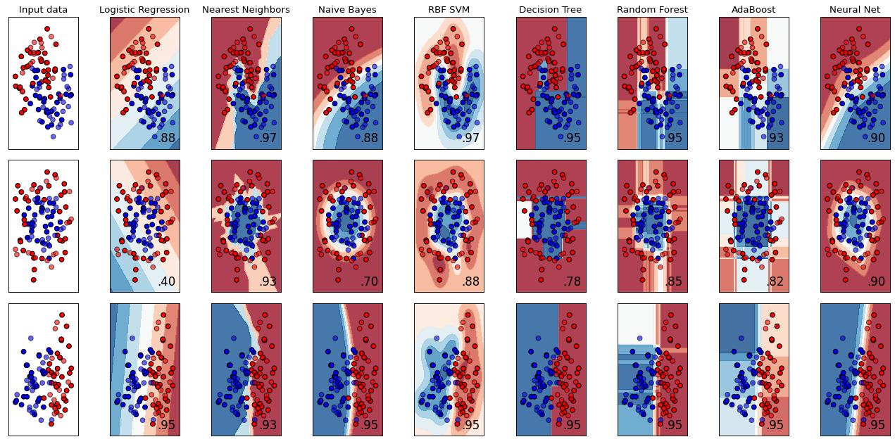
Source: https://scikit-learn.org/stable/auto_examples/classification/plot_classifier_comparison.html

Slide 25
Overfitting

Slide 26
Underfitting

Slide 27
Good / Robust fit

Slide 28
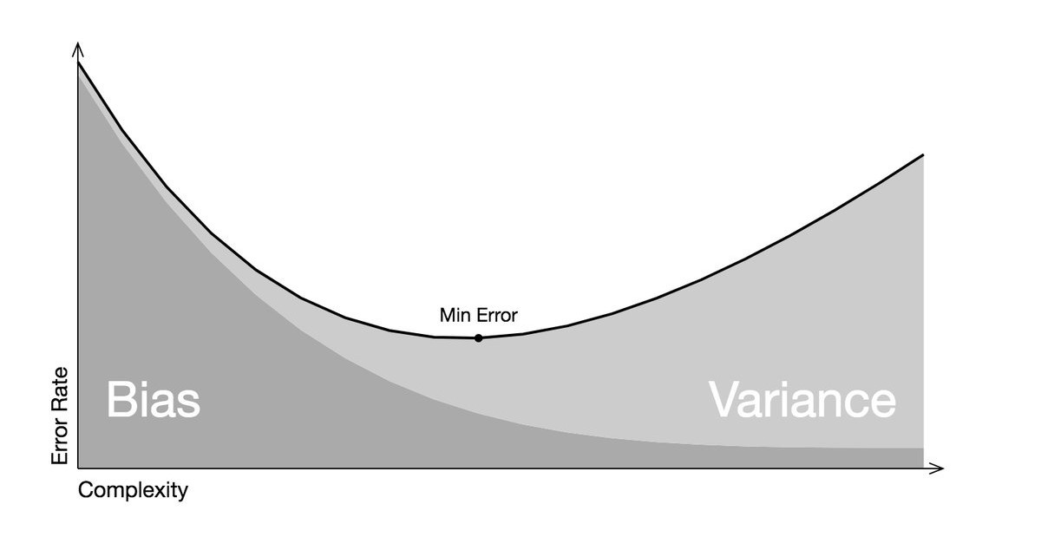
Bias-Variance Tradeoff

Slide 29
Outline
Course Overview
Terminologies & Concepts
Applications
Challenge of Modelling

Slide 30

Data-based Prediction

Slide 31
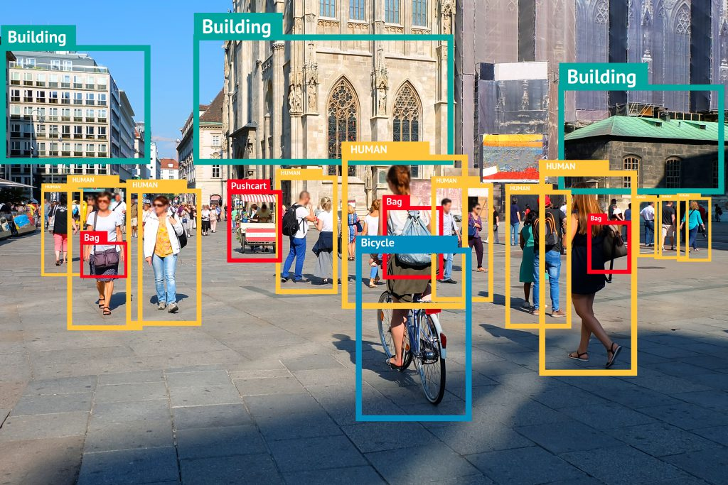
Object Detection & Recognition

Slide 32

Natural Language Processing

Slide 33
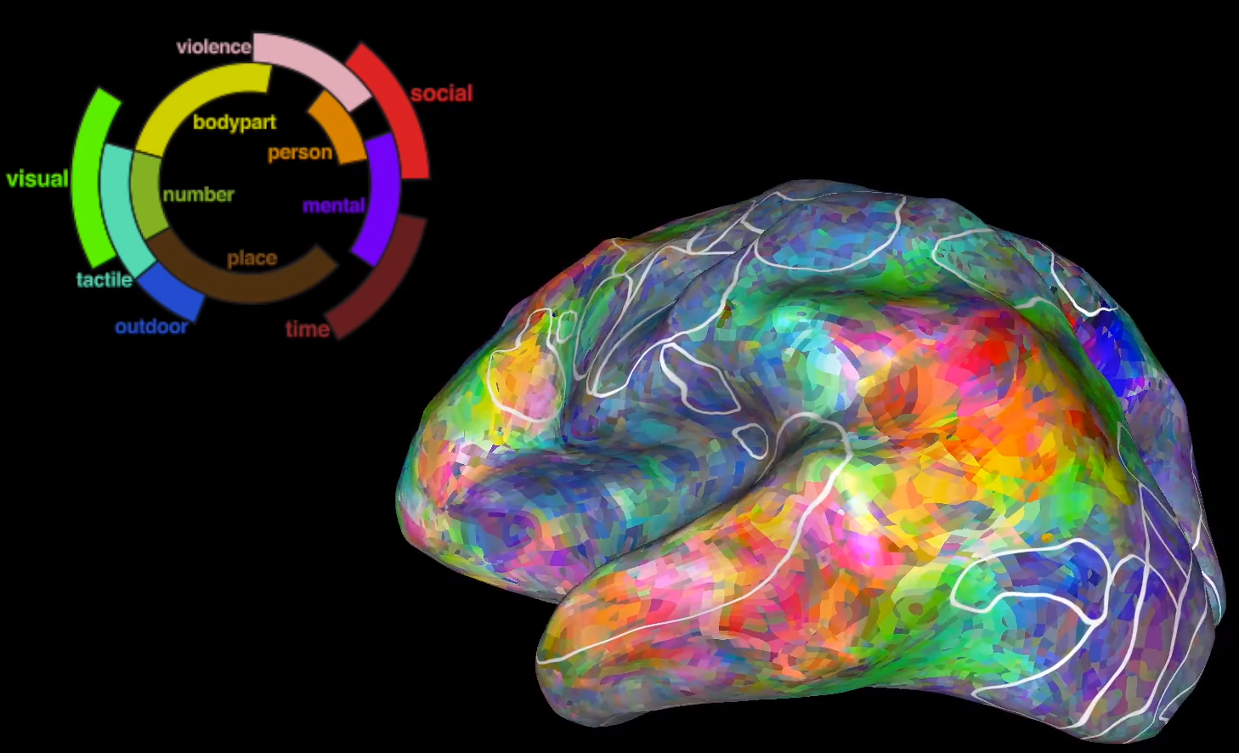
Brain-Reading in Neuroscience

Slide 34
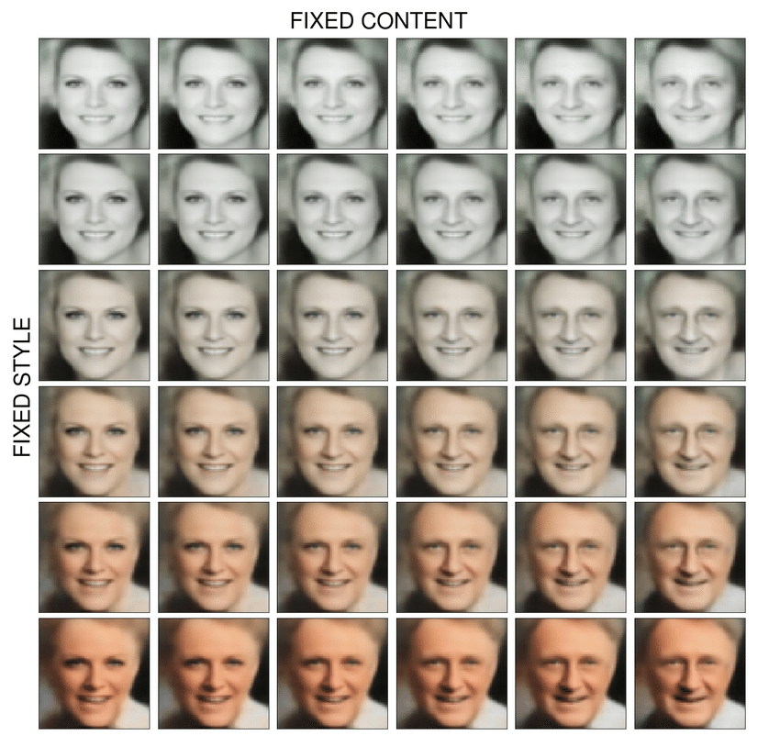
Generative Model

Slide 35
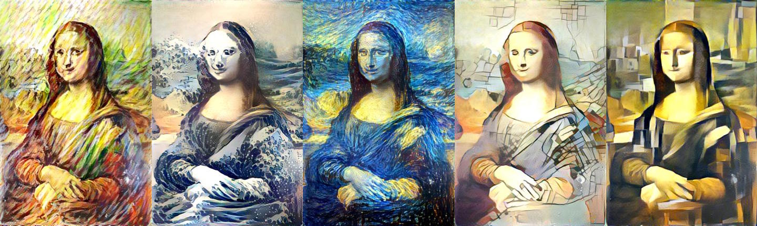
Style-Transfer

Slide 36
Outline
Course Overview
Terminologies & Concepts
Applications
Challenge of Modelling

Slide 37
Challenge.

Slide 38
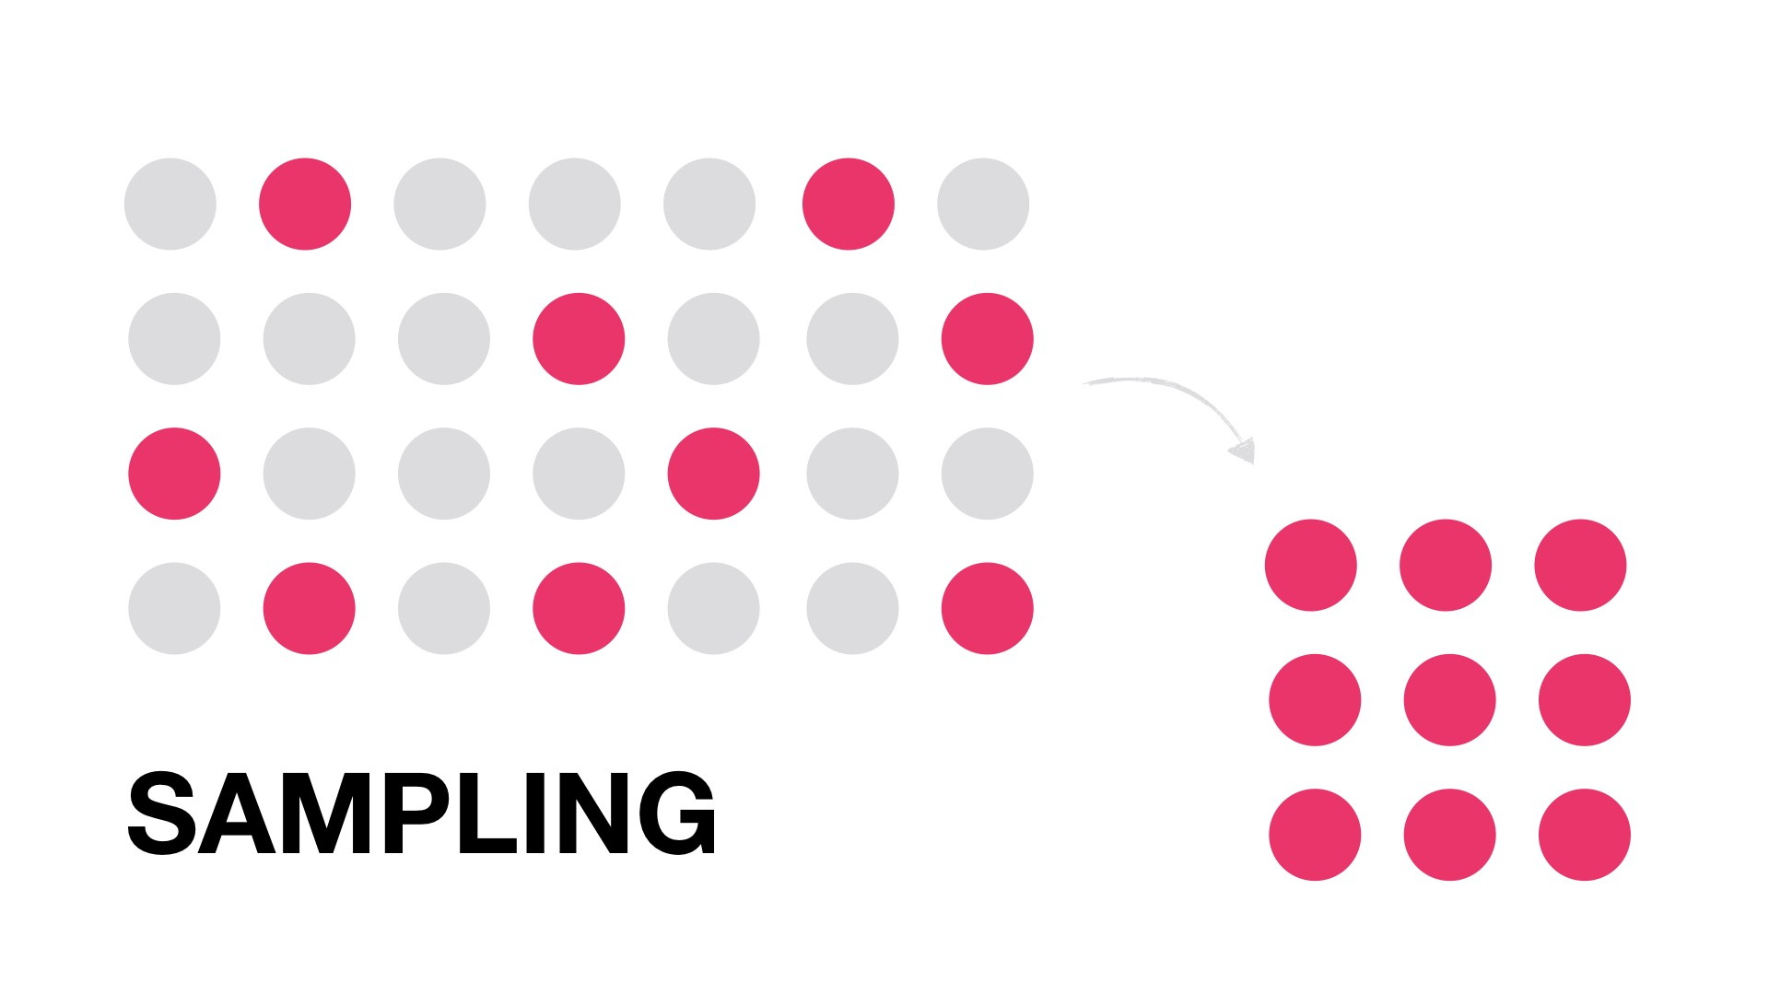
Representativeness of Data

Slide 39
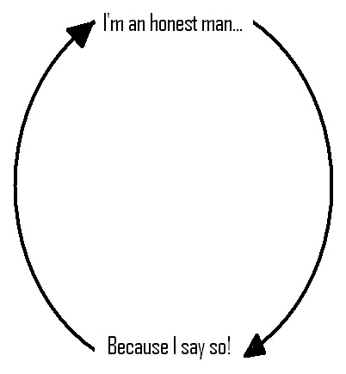

Reasoning Justice （Correlation ǂ Causation）
Circular Reasoning

Slide 40




Slide 41
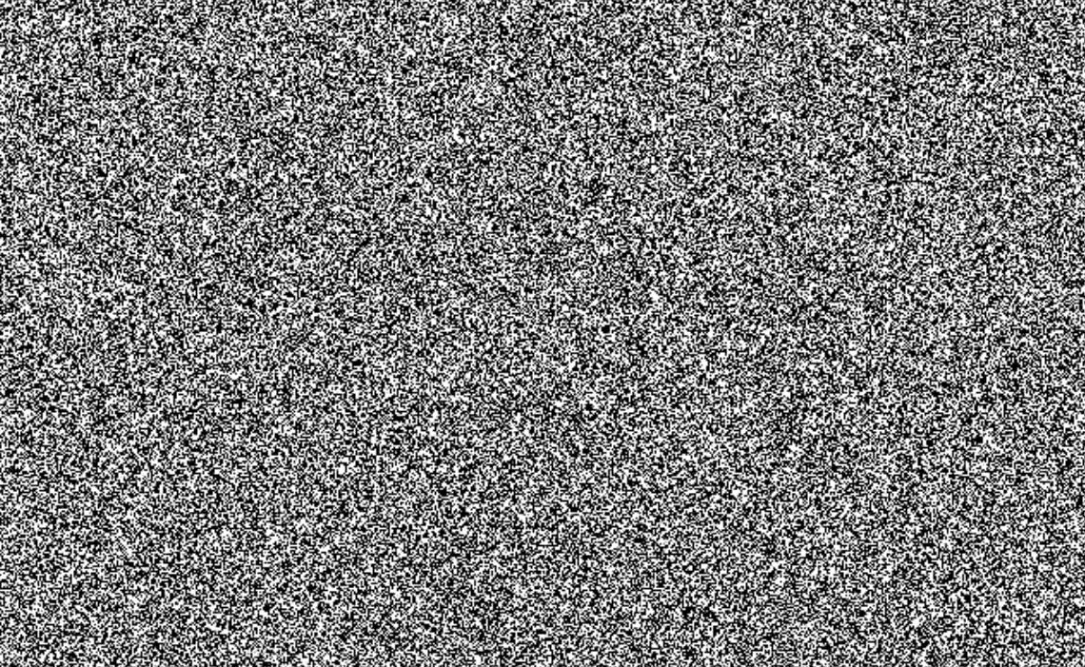
Quality of Data

Slide 42
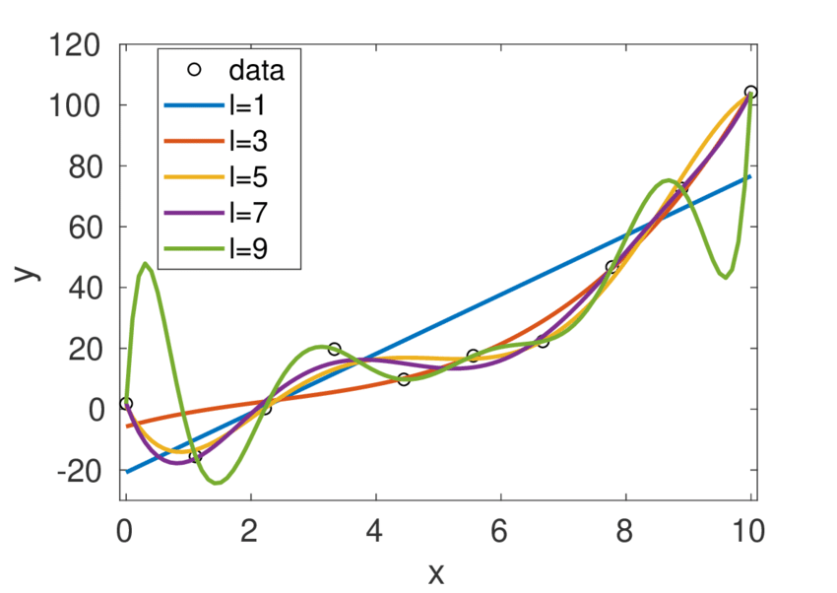
Quantity of Data

Slide 43

To predict, or not to predict?

Slide 44
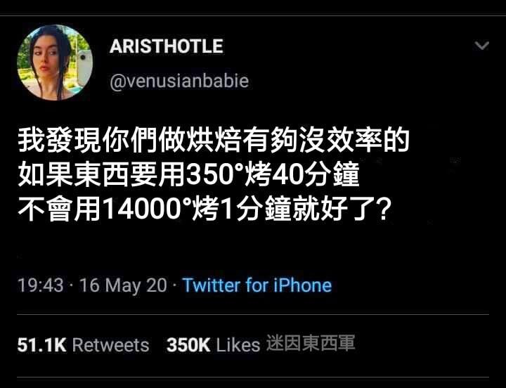

Slide 45
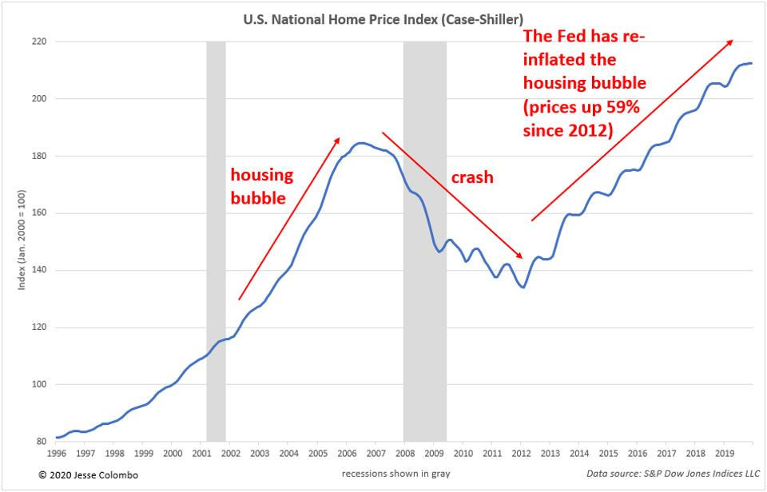
Cyclical Recession &Noise

Slide 46

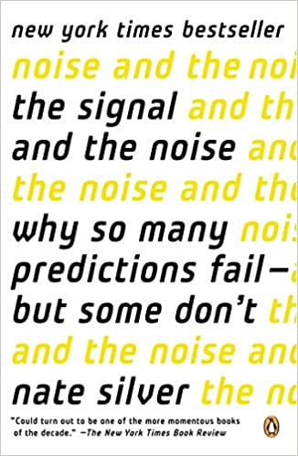


Slide 47

Thank You
FOR WATCHING AND LISTENING

